Slide 1

12:34
12:39
12:49
12:52

Slide 2




Slide 4


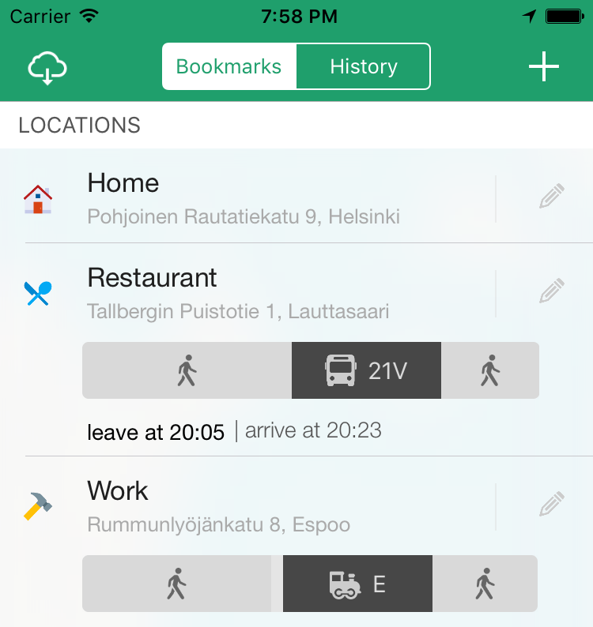

Slide 5



Slide 6


Slide 7








Slide 10


Slide 11
Helsinki 12:30
http://www.fontspace.com/category/thin?p=2
http://www.fontspace.com/nimavisual/trench

Slide 12




Slide 13





Slide 16






Slide 17
M

Slide 18


Slide 19



Slide 20


Slide 21





Slide 22


Slide 27





Slide 28


Slide 29



Slide 43



Slide 44


Slide 45


Slide 46


Slide 49


Slide 50



Slide 51


Slide 52







Slide 53





Slide 54


Ewket Apps
®
Ewket Apps
®

Slide 55










Slide 57




Slide 58


Slide 59



Slide 61

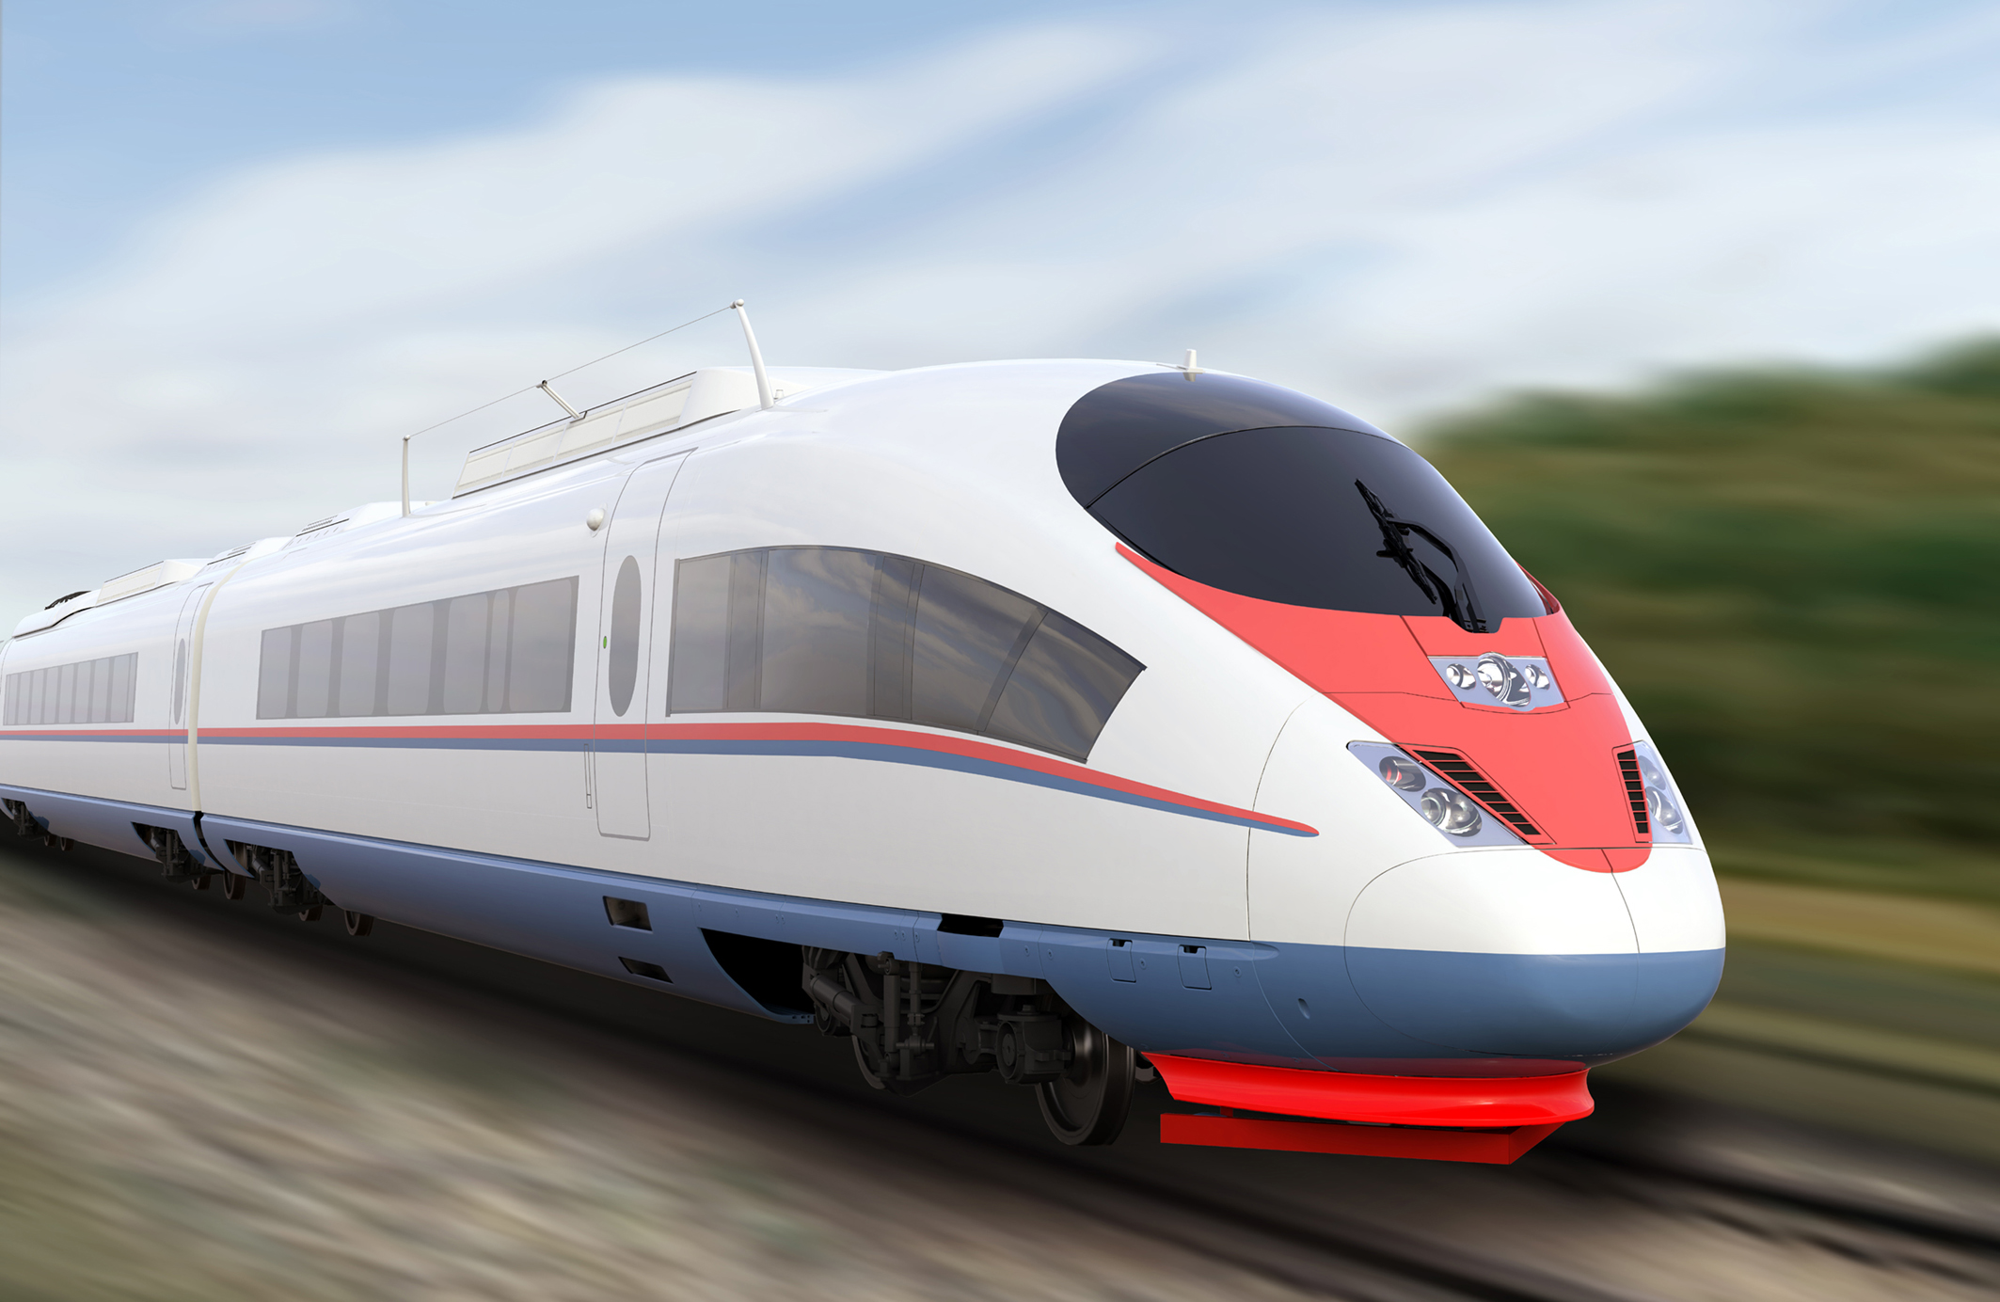

Slide 63
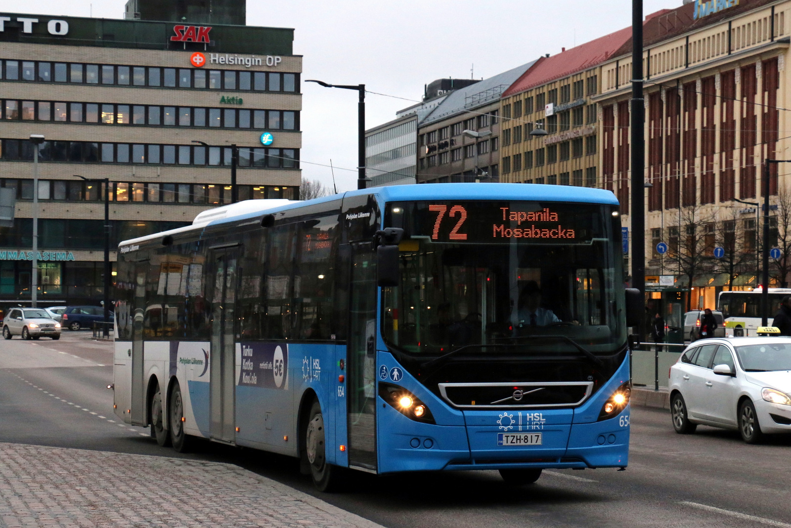

Slide 65


Slide 66
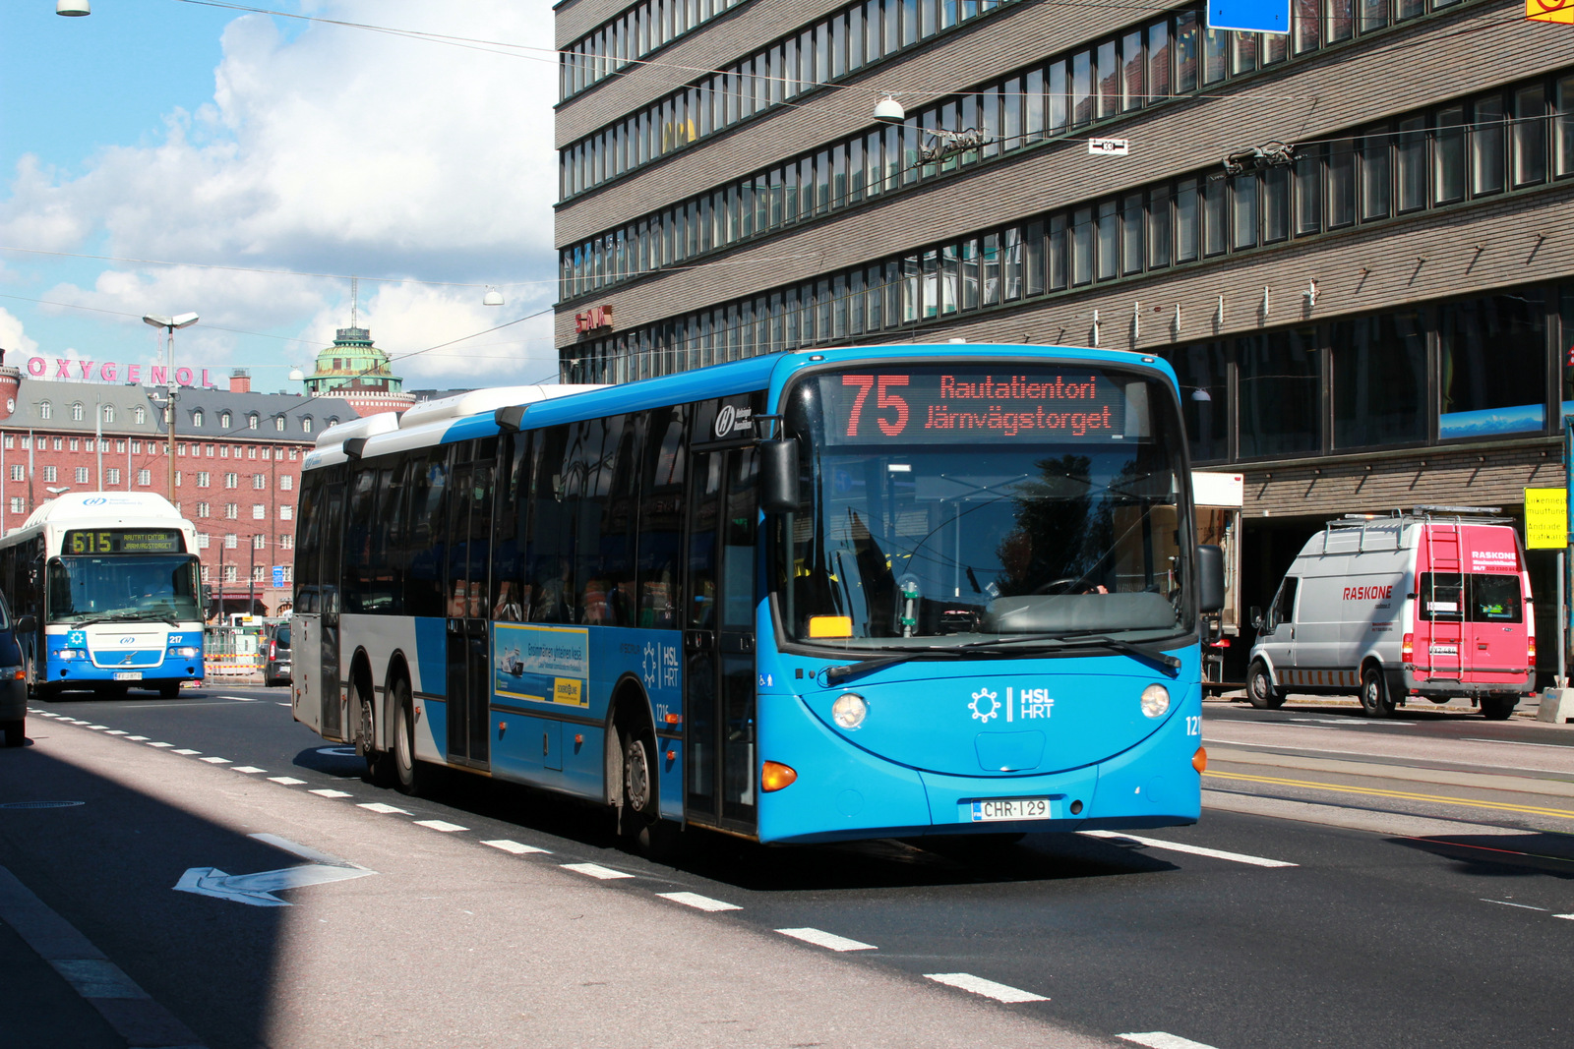

Slide 67


Slide 68


Slide 70
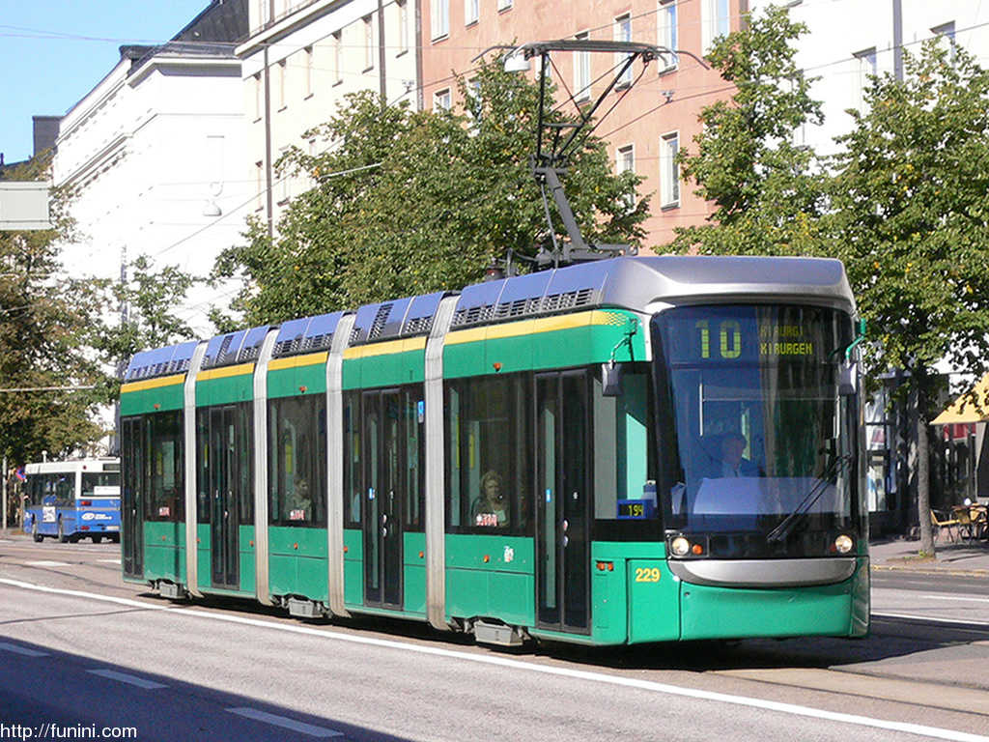

Slide 72


Slide 74
C
B
A - > C
B -> X
X = (b * C)/A
Dif = (A – B)/2
A
C * (1 – B/A)/2

